Slide 1
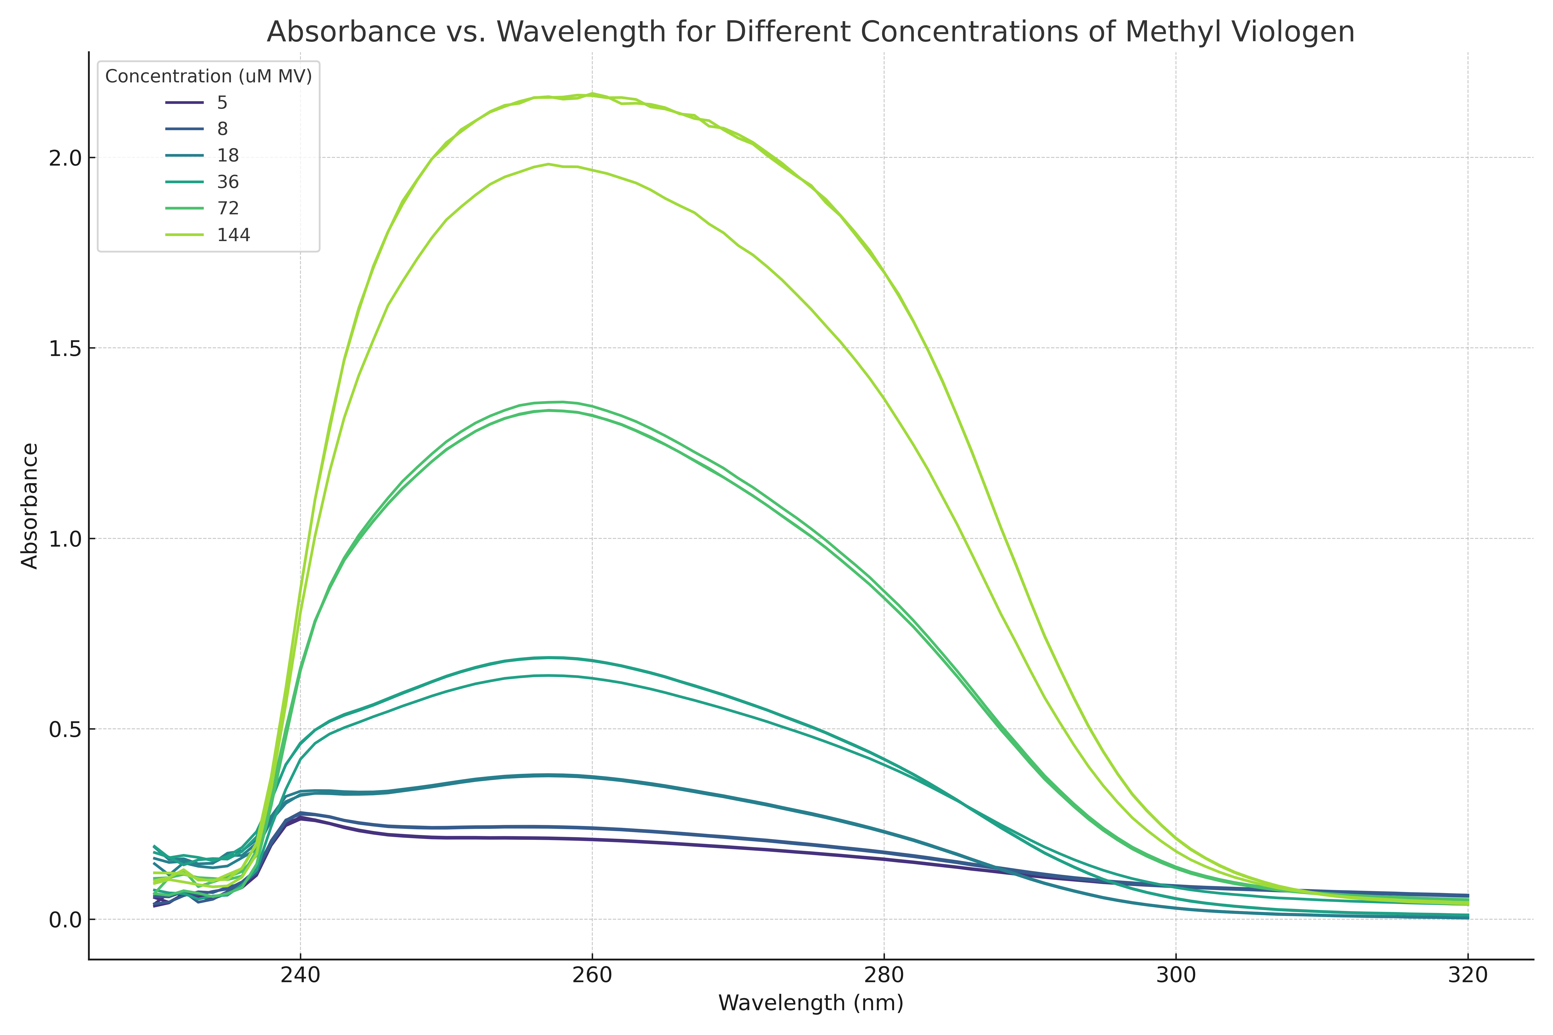
Quantifying MV Spectrophotometrically
Not much difference between 5 and 8 uM MV (bioassays required 6 uM MV)…

Slide 2
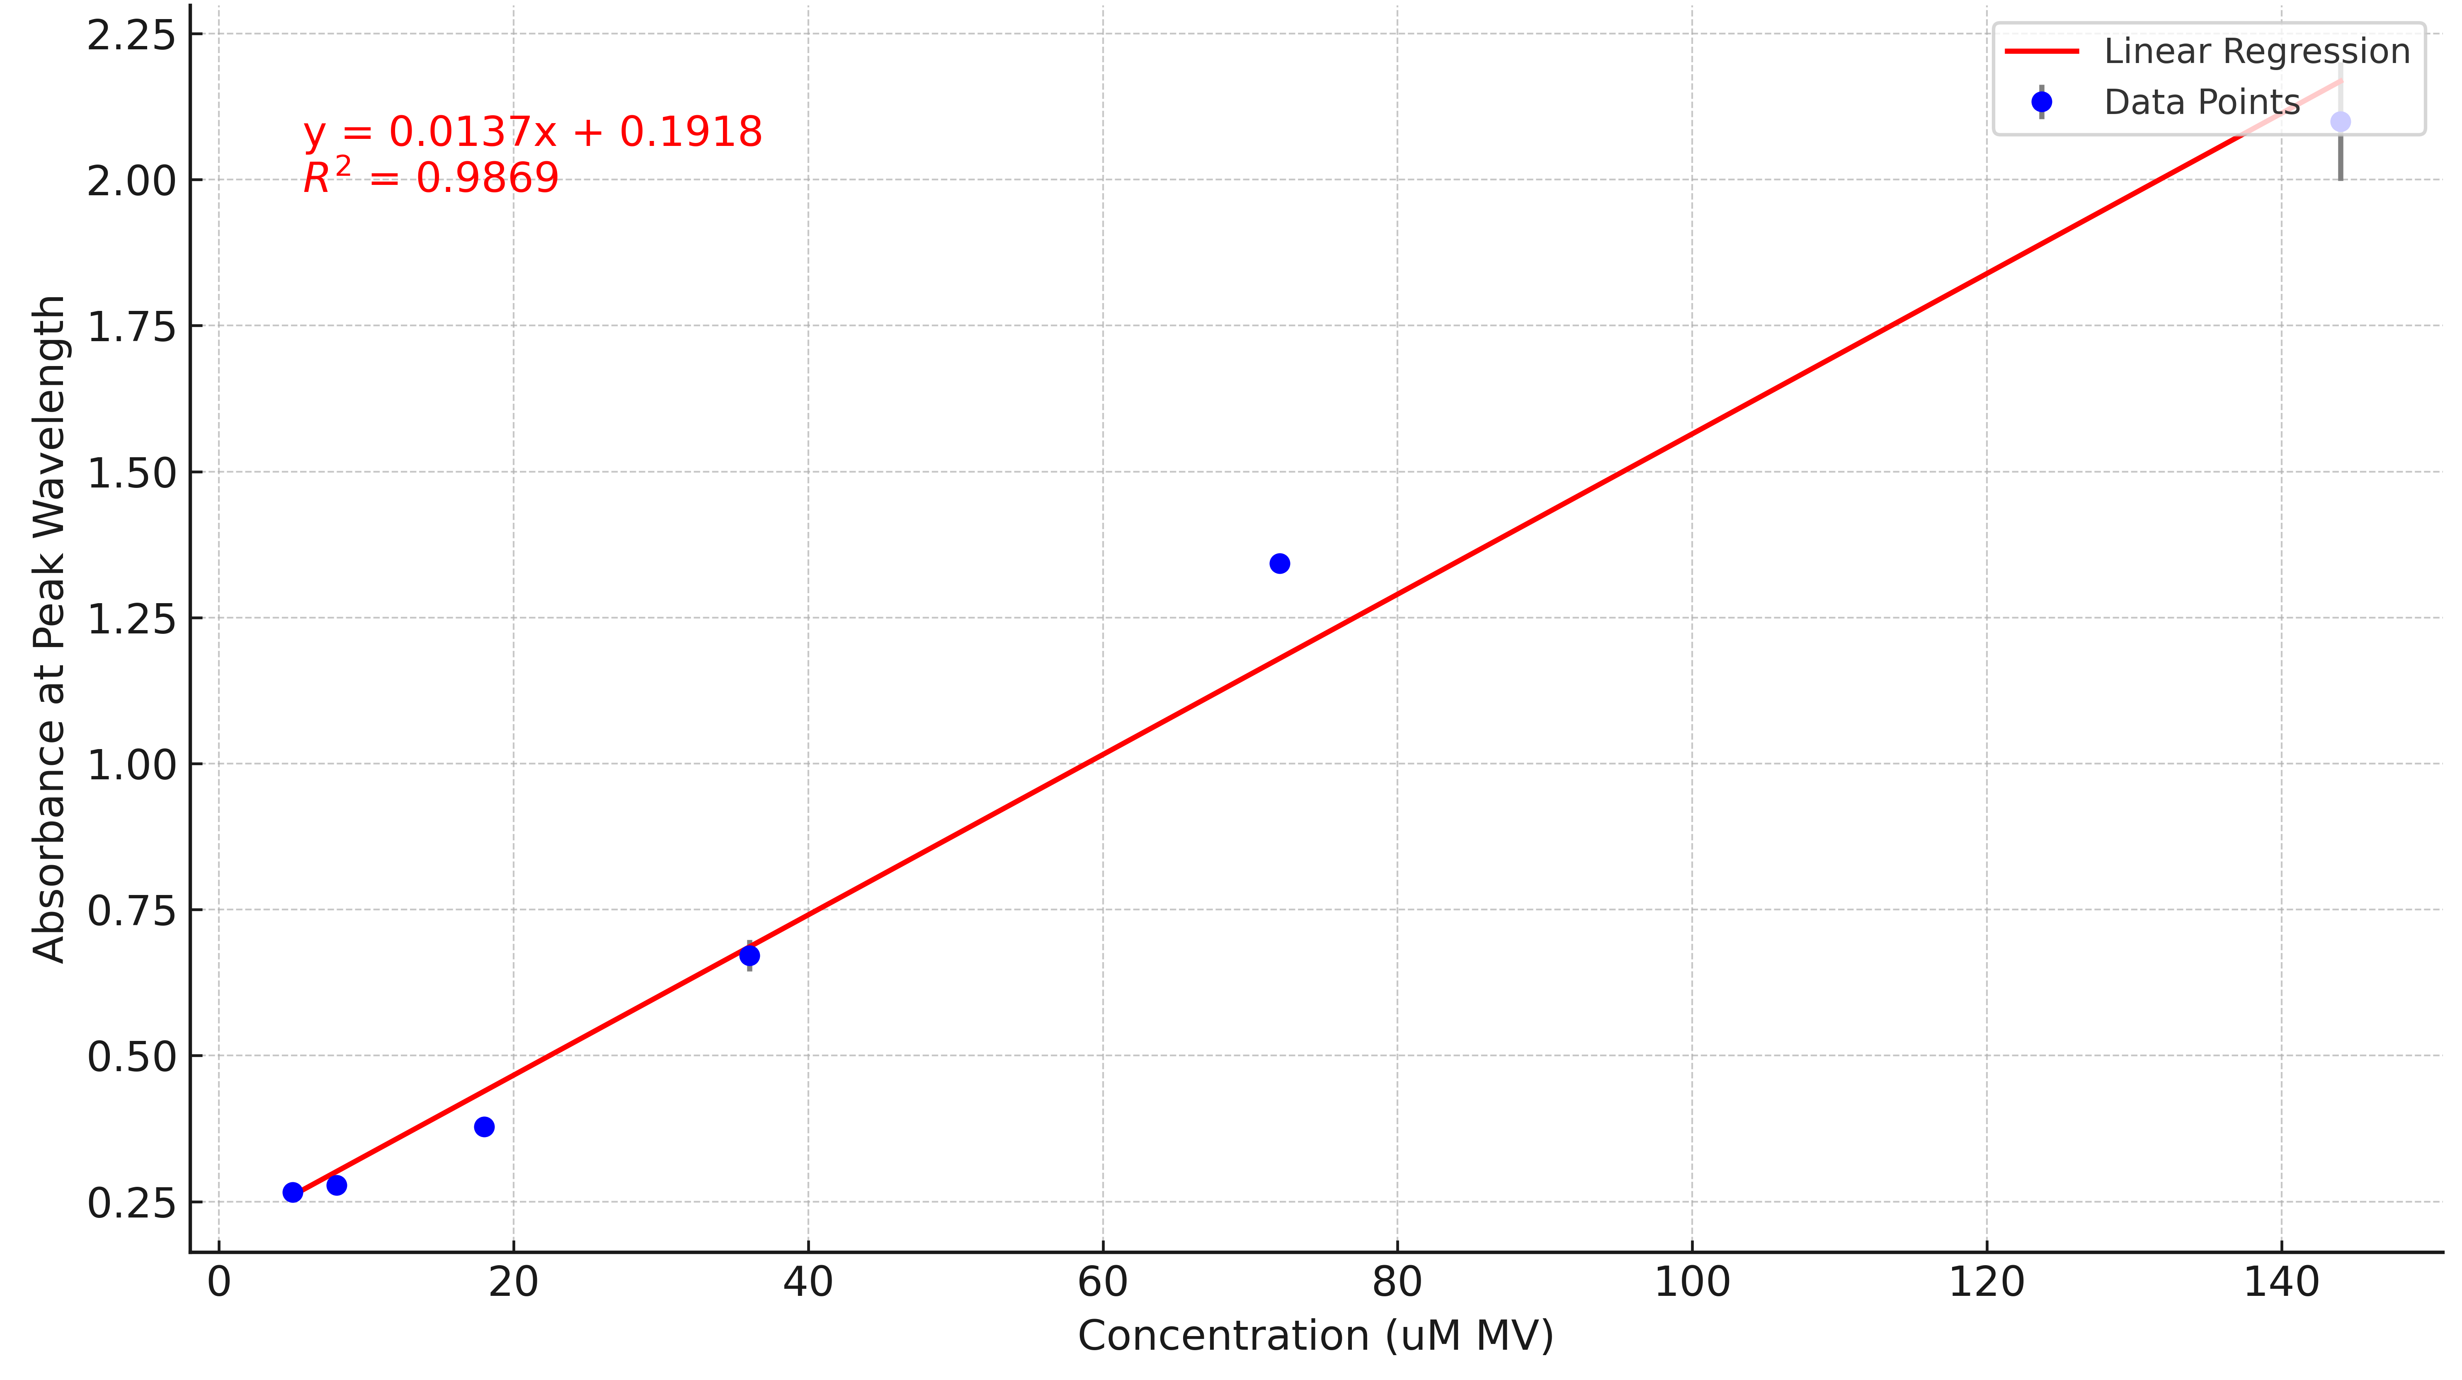
*bioassays are in this range…outside of linear rante required for Beer-Lambert law…

Slide 3
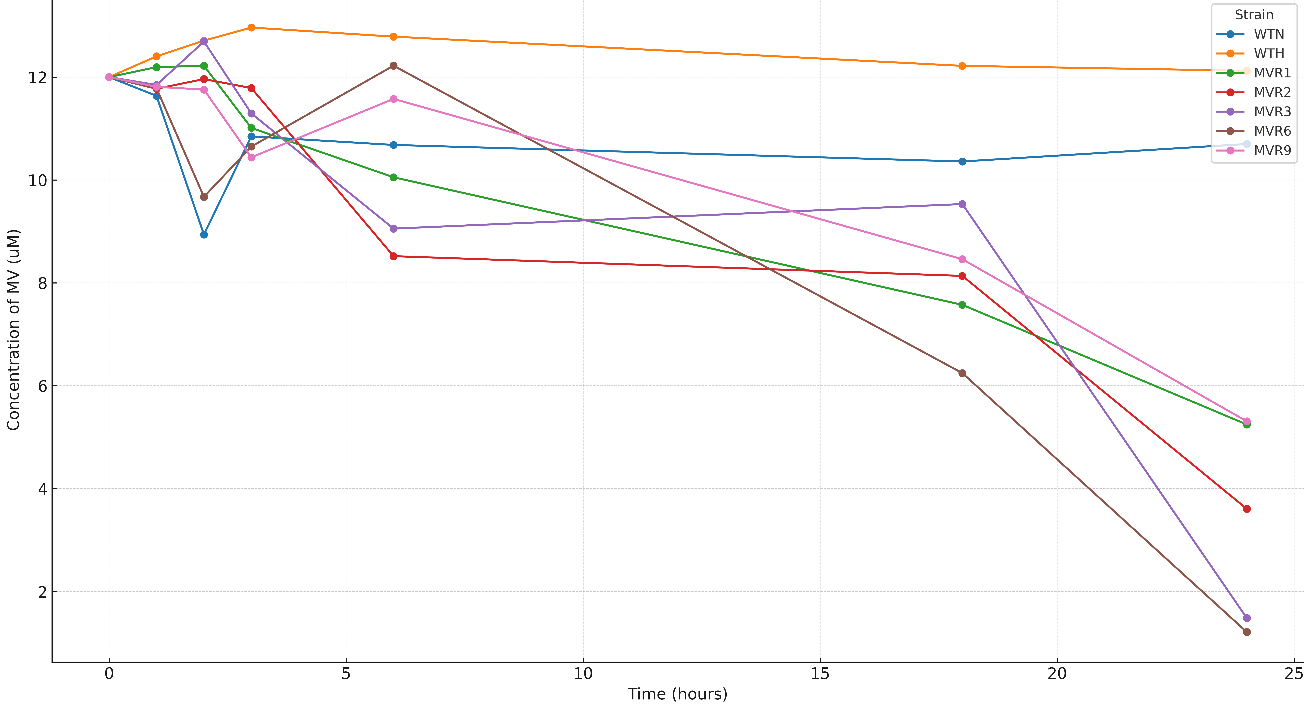
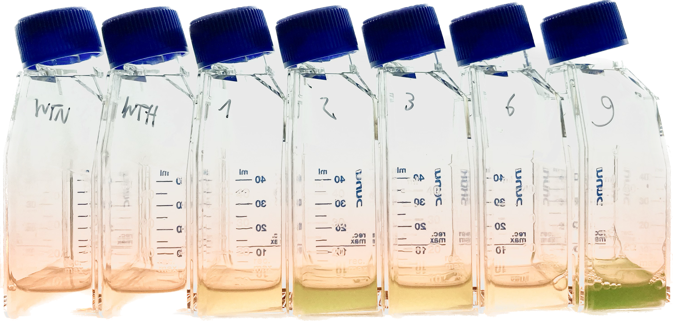
Decreased [MV²⁺] in the supernatant of resistant strains ?!
I tried to perform a bioassay using twice as much MV initially (12 uM) maybe something can be observed…but very noisy …

